Slide 1
Working with calendars in Community Solid Server
Pieter Heyvaert
pieter.heyvaert@ugent.be - @HeyPieter
Ghent University - IDLab, imec

Slide 2
You can schedule meeting with someone
via multiple methods
Send a chat message
Send an email
Give a call
But what when scheduling a meeting with multiple people?

Slide 3
You schedule meeting with multiple people
via different methods
Check shared calendar
→ Not always up to date or complete
Send out a Doodle
→ People fill it in too late or not at all

Slide 4
Problem: how to make it easier to schedule
a meeting with multiple people?

Slide 5
Solution: create busy calendar using Community Solid Server

Slide 6
Overview
Example
Extensibility of Community Solid Server
Different representations of calendars
Server configuration
Build on top of this work

Slide 7
Overview
Example
Extensibility of Community Solid Server
Different representations of calendars
Server configuration
Build on top of this work

Slide 8
Example: work and personal calendar → busy calendar
Work calendar:
Work-related events
Details can be shared with colleagues
Personal calendar:
Personal events
Details cannot be shared with colleagues
Busy calendar:
Aggregation of work and personal calendars
Details can be shared with colleagues

Slide 9
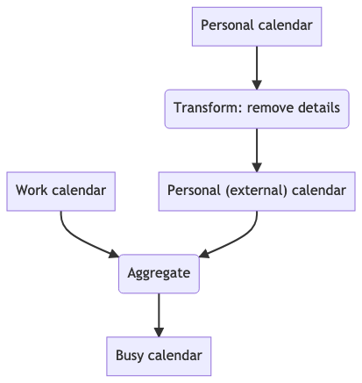
Example: work and personal calendar → busy calendar

Slide 10
Overview
Example
Extensibility of Community Solid Server
Different representations of calendars
Server configuration
Build on top of this work

Slide 11
Extensibility of Community Solid Server
Support new types of data
Support new functionality
→ Custom stores
Represent collections of resources
Allow manipulating these resources
Read: plugins (JavaScript)
In example: calendars are resources

Slide 12
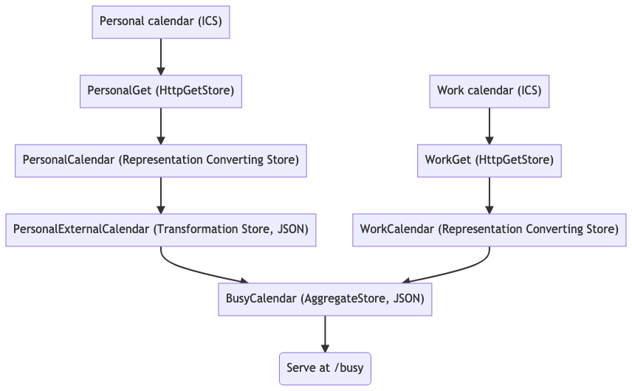
Custom stores for work, personal, and busy calendars

Slide 13
Overview
Example
Extensibility of Community Solid Server
Different representations of calendars
Server configuration
Build on top of this work

Slide 14
Get busy calendar at http://localhost:3000/busy
Internal JSON representation
{
"name":"Aggregated calendar of Personal example and Work example",
"events":[
{
"title":"[Personal example] Busy",
"startDate":"2021-04-08T15:00:00.000Z",
"endDate":"2021-04-08T17:00:00.000Z",
"hash":"c585549052f444427a1528a430c001b5",
"location":""
},
// The remainder of the events are excluded for brevity.
]
}

Slide 15
Get busy calendar at http://localhost:3000/busy
ICS representation
BEGIN:VCALENDAR
VERSION:2.0
PRODID:-//sebbo.net//ical-generator//EN
NAME:Aggregated calendar of Free Time example and Work example
X-WR-CALNAME:Aggregated calendar of Free Time example and Work example
BEGIN:VEVENT
UID:7abb9807-4d85-47db-81da-10ccca0a7672
SEQUENCE:0
DTSTAMP:20210817T122516Z
DTSTART:20210408T150000Z
DTEND:20210408T170000Z
SUMMARY:[Free Time example] Busy
END:VEVENT
BEGIN:VEVENT
UID:dd379c3c-b653-4a49-91e0-78b00cdabe23
SEQUENCE:0
DTSTAMP:20210817T122516Z
DTSTART:20210330T060000Z
DTEND:20210330T160000Z
# The remainder of the events are excluded for brevity.

Slide 16
Get RDF representation of busy calendar
Instance of Solid RML Store specific for internal JSON representation of calendar
@prefix schema: <http://schema.org/> .
@prefix calendar: <http://example.com/calendar/> .
@prefix event: <http://example.com/event/> .
calendar:Aggregated%20calendar%20of%20Personal%20Time%20example%20and%20Work%20example
schema:event event:09ec6f847b05ebc845da09f9777bca98,
event:500fa723b22615892e91b64405b5a32c, event:98dd5445ee418eb6a0aeeb1da537a9a4,
event:b22e5eed1e7599d6ea64d9e1b1150bfb, event:c585549052f444427a1528a430c001b5;
schema:name "Aggregated calendar of Personal example and Work example" .
event:09ec6f847b05ebc845da09f9777bca98 a schema:Event;
schema:description "";
schema:endDate "2021-08-03T18:00:00.000Z";
schema:location "";
schema:name "[Work example] Meeting";
schema:startDate "2021-08-03T16:15:00.000Z" .
# The remainder of the events are excluded for brevity.

Slide 17
Overview
Example
Extensibility of Community Solid Server
Different representations of calendars
Server configuration
Build on top of this work

Slide 18
No code needed, instead update server configuration
Library (plugin) “Solid Calendar Store” (JavaScript) defines custom stores
Add instances different stores to server configuration
HTTP Get Store
Transformation Store
Aggregate Store
Configure instances
URLs of original calendars
How to transform calendars
What calendars to aggregate

Slide 19
Overview
Example
Extensibility of Community Solid Server
Different representations of calendars
Server configuration
Build on top of this work

Slide 20
You can build on top of these stores
Define your own calendars
Use output of our stores as input for your custom stores
Use JSON representation
Use RDF representation
Use transformation
Use aggregation
Solid Calendar Store is open source → adapt to your needs

Slide 21
Find out more
Community Solid Server: github.com/solid/community-server
Solid Calendar Store: github.com/KNowledgeOnWebScale/solid-calendar-store
Solid RML Store: github.com/RMLio/solid-rml-store
Blog post: knows.idlab.ugent.be/blog/solid-calendar-store

Slide 22
Working with calendars in Community Solid Server
Pieter Heyvaert
pieter.heyvaert@ugent.be - @HeyPieter
Ghent University - IDLab, imec

